Slide 1

Major Project
Medicwise (Healthcare)
Medicwise is a doctor consultation website that facilitates chat, video calls, and gesture-based video calls for handicapped-people. It provides easy authentication using Firebase & seamless payment using Stripe.
Kartik Mehta | 2000290110079

Slide 2

Problem Statement – UNSDG Goal 3
A serious healthcare problem issue released by United Nation:
In 2020 and 2021, 14.9 million people were estimated to have died due to COVID-19 and its impact.
Interruptions in essential health services were reported in 92 per cent of 129 countries surveyed at the end of 2021.
As of May 2022, more than 80 per cent of people had received at least one dose of a vaccine in high-income countries but the proportion is only about 17 per cent in low-income countries.
Between January 2020 and May 2021, the pandemic may have claimed the lives of 115,500 health and care workers worldwide.
7 million children missed out on vaccinations in 2020, 3.7 million more than in 2019 and the highest number since 2005.

Slide 3
Problem Statement – Analysis
We have been forced to stay at home due to the pandemic, and people are doubtful about going out to consult doctors nowadays.
People are opting for online personal health care.
As a result, we developed a personal care web app that allows patients to consult doctors from the comfort of their own homes.
There are over a million deaf & dumb people. There are over 75% of people are uneducated.
So we've devised Medicwise as a solution to the problem, so that it is accessible to everyone, regardless of their disabilities, to consult a doctor online.

Slide 4
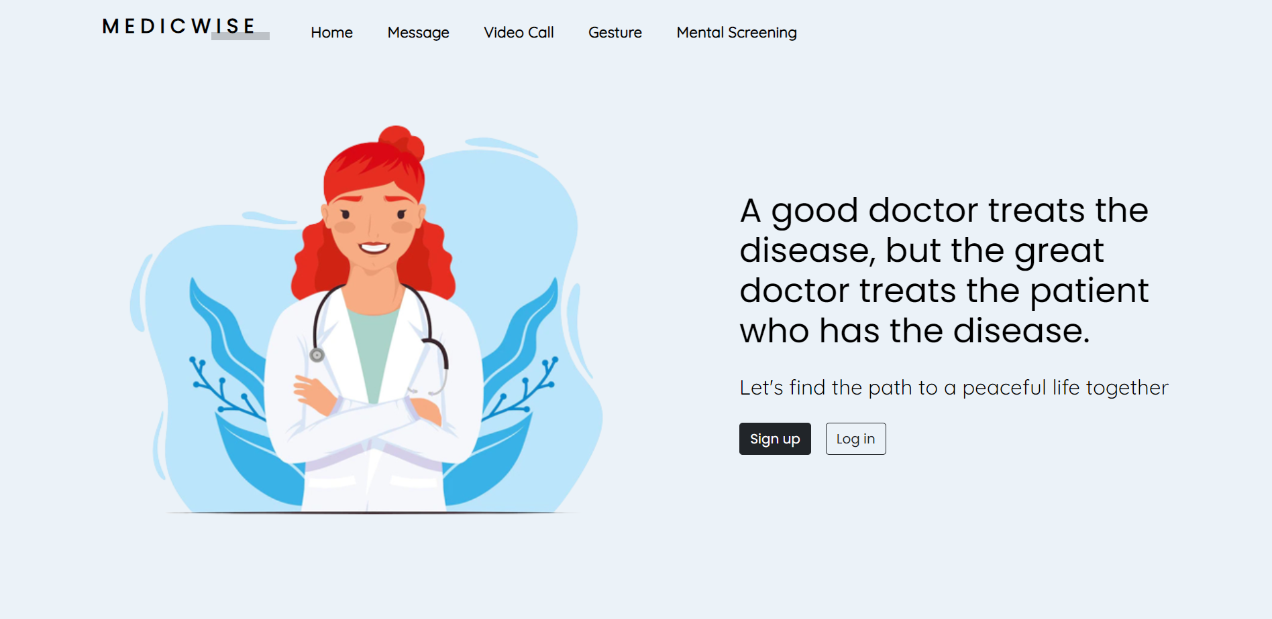
Solution
There is a separate Admin Portal dedicated for the doctors.
Each portion of the Medicwise will have its own Room ID, given to patients by the respective doctors they want to consult. Each doctor will have their own medic code so that patients can appoint them.
There is a chat room where you can communicate with your doctor.
There is a video room where you may communicate with your doctor via video call.
Lastly, there is a gesture room where mute and uneducated people can communicate with doctors using sign language.
If the doctor doesn't understand sign language, we have machine learning models implemented using tensorflow that can decode sign language into text.
The patient authentication is facilitated with Firebase Authentication. [with custom Email/Password or Google]
The seamless payment gateway implemented using Stripe.

Slide 5
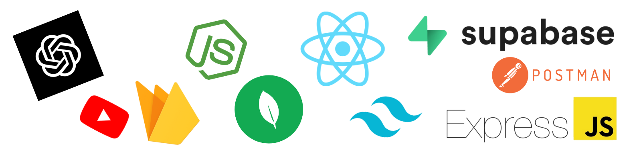
Technology Stack
Frontend: HTML, CSS, SCSS, Javascript, ReactJs, Bootstrap, MaterialUI, TailwindCSS
Backend: NodeJs, ExpressJs, SocketIO, TensorflowJs
Database: MongoDB, Stripe
Cloud/Hosting: Microsoft Azure, Netlify, GitHub Actions, Firebase
Computer Vision: OpenCV, Mediapipe
Blockchain: Ethereum, IPFS, Smart Contracts

Slide 6
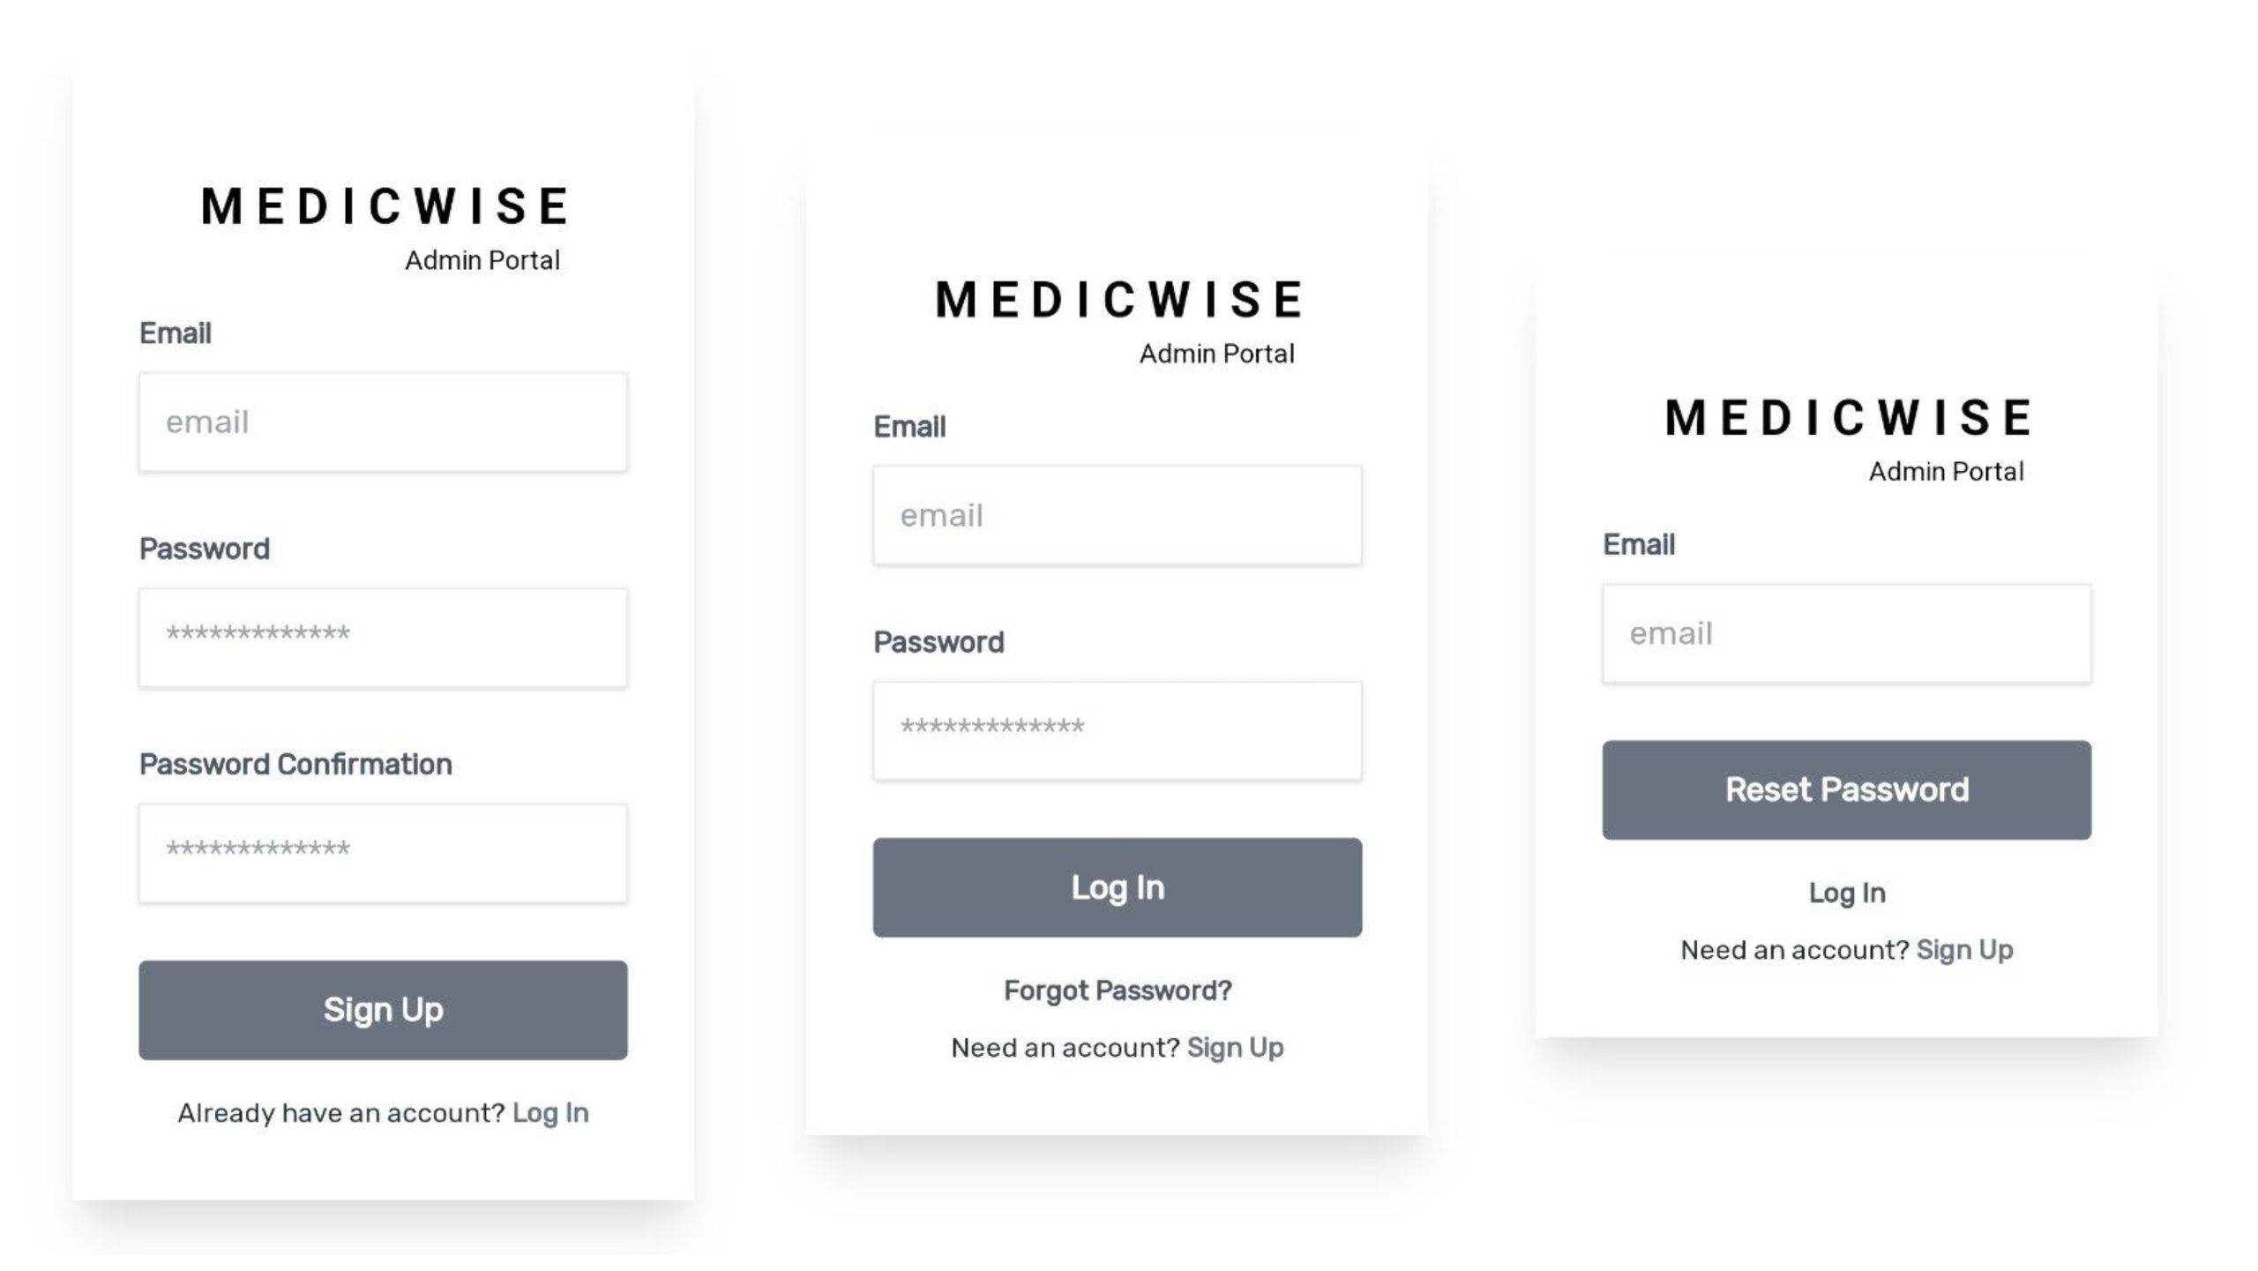
Future Scope for product
Text-to-Gesture Encoding from Doctor to Client.
Implementing a chat box in the video section.
Implementing chat bot.
Training ML model to encode and decode many gestures.

Slide 7
Research Papers
Scalable blockchain storage systems: research progress and models (2021)
A real-time continuous gesture recognition system for sign language (2021)
Web Accessibility Evaluation Methods: A Systematic Review
Applications of Blockchain Technology in Medicine and Healthcare: Challenges and Future Perspectives (2020)

Slide 8
THANK YOU

